Slide 1
Huffman Coding
Vida Movahedi
October 2006

Slide 2
Contents
A simple example
Definitions
Huffman Coding Algorithm
Image Compression

Slide 3
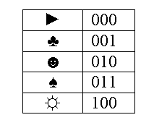
A simple example
Suppose we have a message consisting of 5 symbols, e.g. [►♣♣♠☻►♣☼►☻]
How can we code this message using 0/1 so the coded message will have minimum length (for transmission or saving!)
5 symbols → at least 3 bits
For a simple encoding,
length of code is 10*3=30 bits

Slide 4
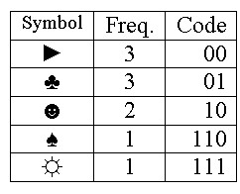
A simple example – cont.
Intuition: Those symbols that are more frequent should have smaller codes, yet since their length is not the same, there must be a way of distinguishing each code
For Huffman code,
length of encoded message
will be ►♣♣♠☻►♣☼►☻
=3*2 +3*2+2*2+3+3=24bits

Slide 5

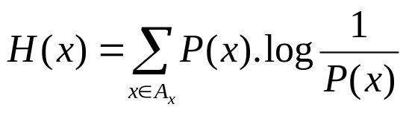
Definitions
An ensemble X is a triple (x, A_{x}, P_{x})
  x: value of a random variable
  A_{x}: set of possible values for x , A_{x}={a₁, a₂, …, a_{I}}
  P_{x}: probability for each value , P_{x}={p₁, p₂, …, p_{I}}
  where P(x)=P(x=a_{i})=p_{i}, p_{i}>0,
Shannon information content of x
  h(x) = log₂(1/P(x))
Entropy of x
i | a_{i} | p_{i} | h(p_{i})
1 | a | .0575 | 4.1
2 | b | .0128 | 6.3
3 | c | .0263 | 5.2
.. |  | .. | ..
26 | z | .0007 | 10.4

Slide 6
Source Coding Theorem
There exists a variable-length encoding C of an ensemble X such that the average length of an encoded symbol, L(C,X), satisfies
  L(C,X)∈[H(X), H(X)+1)
The Huffman coding algorithm produces optimal symbol codes

Slide 7
Symbol Codes
Notations:
  A^{N}: all strings of length N
  A⁺: all strings of finite length
  {0,1}³={000,001,010,…,111}
  {0,1}⁺={0,1,00,01,10,11,000,001,…}
A symbol code C for an ensemble X is a mapping from A_{x} (range of x values) to {0,1}⁺
c(x): codeword for x, l(x): length of codeword

Slide 8
Example
Ensemble X:
  A_{x}= { a , b , c , d }
  P_{x}= {1/2 , 1/4 , 1/8 , 1/8}
c(a)= 1000
c⁺(acd)=
  100000100001
  (called the extended code)
a_{i}
c(a_{i})
l_{i}
a
1000
4
C₀:
b
0100
4
c
0010
4
d
0001
4

Slide 9
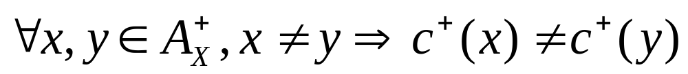
Any encoded string must have a unique decoding
A code C(X) is uniquely decodable if, under the extended code C⁺, no two distinct strings have the same encoding, i.e.

Slide 10
The symbol code must be easy to decode
If possible to identify end of a codeword as soon as it arrives
→no codeword can be a prefix of another codeword
A symbol code is called a prefix code if no code word is a prefix of any other codeword
  (also called prefix-free code, instantaneous code or self-punctuating code)

Slide 11
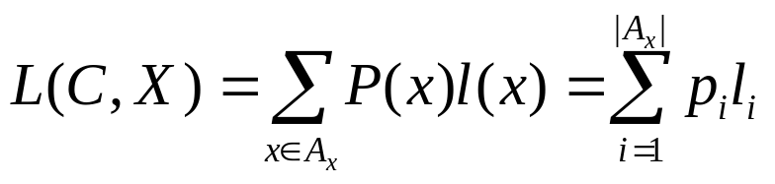
The code should achieve as much compression as possible
The expected length L(C,X) of symbol code C for X is

Slide 12
Example
Ensemble X:
  A_{x}= { a , b , c , d }
  P_{x}= {1/2 , 1/4 , 1/8 , 1/8}
c⁺(acd)=
  0110111
  (9 bits compared with 12)
prefix code?
a_{i}
c(a_{i})
l_{i}
a
0
1
C₁:
b
10
2
c
110
3
d
111
3

Slide 13
The Huffman Coding algorithm- History
In 1951, David Huffman and his MIT information theory classmates given the choice of a term paper or a final exam
Huffman hit upon the idea of using a frequency-sorted binary tree and quickly proved this method the most efficient.
In doing so, the student outdid his professor, who had worked with information theory inventor Claude Shannon to develop a similar code.
Huffman built the tree from the bottom up instead of from the top down

Slide 14
Huffman Coding Algorithm
Take the two least probable symbols in the alphabet
  (longest codewords, equal length, differing in last digit)
Combine these two symbols into a single symbol, and repeat.

Slide 15
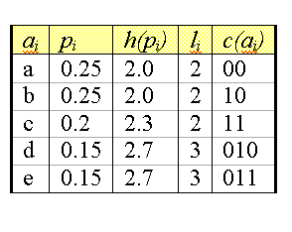
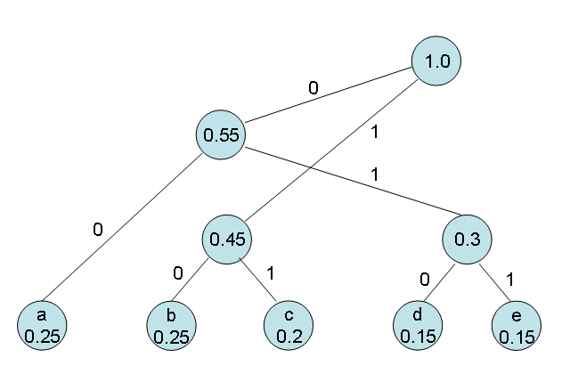
Example
A_{x}={ a , b , c , d , e }
P_{x}={0.25, 0.25, 0.2, 0.15, 0.15}
1.0
0
0.55
1
1
0
0.45
0.3
0
1
0
1
a
0.25
b
0.25
c
0.2
d
0.15
e
0.15
00
10
11
010
011

Slide 16
Statements
Lower bound on expected length is H(X)
There is no better symbol code for a source than the Huffman code
Constructing a binary tree top-down is suboptimal

Slide 17
Disadvantages of the Huffman Code
Changing ensemble
  If the ensemble changes→ the frequencies and probabilities change → the optimal coding changes
  e.g. in text compression symbol frequencies vary with context
  Re-computing the Huffman code by running through the entire file in advance?!
  Saving/ transmitting the code too?!
Does not consider ‘blocks of symbols’
  ‘strings_of_ch’ →the next nine symbols are predictable ‘aracters_’ , but bits are used without conveying any new information

Slide 18
Variations
n-ary Huffman coding
  Uses {0, 1, .., n-1} (not just {0,1})
Adaptive Huffman coding
  Calculates frequencies dynamically based on recent actual frequencies
Huffman template algorithm
  Generalizing
    probabilities → any weight
    Combining methods (addition) → any function
  Can solve other min. problems e.g. max [w_{i}+length(c_{i})]

Slide 19
Image Compression
2-stage Coding technique
  A linear predictor such as DPCM, or some linear predicting function → Decorrelate the raw image data
  A standard coding technique, such as Huffman coding, arithmetic coding, …
  Lossless JPEG:
  - version 1: DPCM with arithmetic coding
  - version 2: DPCM with Huffman coding

Slide 20
DPCM
Differential Pulse Code Modulation
DPCM is an efficient way to encode highly correlated analog signals into binary form suitable for digital transmission, storage, or input to a digital computer
Patent by Cutler (1952)

Slide 21
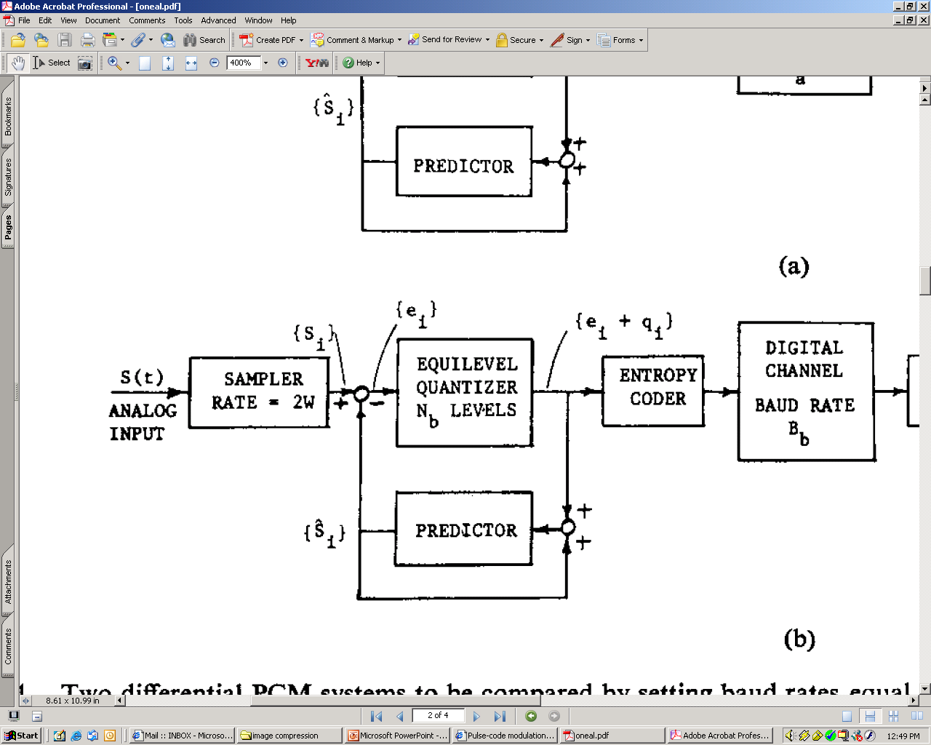
DPCM

Slide 22
Huffman Coding Algorithm for Image Compression
Step 1. Build a Huffman tree by sorting the histogram and successively combine the two bins of the lowest value until only one bin remains.
Step 2. Encode the Huffman tree and save the Huffman tree with the coded value.
Step 3. Encode the residual image.

Slide 23
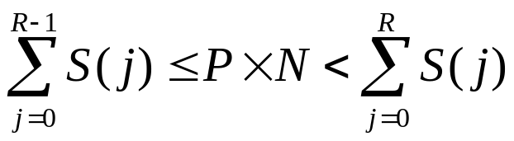
Huffman Coding of the most-likely magnitude
MLM Method
Compute the residual histogram H
  H(x)= # of pixels having residual magnitude x
Compute the symmetry histogram S
  S(y)= H(y) + H(-y), y>0
Find the range threshold R
  for N: # of pixels , P: desired proportion of most-likely magnitudes

Slide 24
References
MacKay, D.J.C. , Information Theory, Inference, and Learning Algorithms, Cambridge University Press, 2003.
Wikipedia, http://en.wikipedia.org/wiki/Huffman_coding
Hu, Y.C. and Chang, C.C., “A new losseless compression scheme based on Huffman coding scheme for image compression”,
O’Neal

